Slide 1

Bitcoin Transaction Ecosystem
Lingfeng Zhou
Chung-Yang Li
Jin Zhang

Slide 2
Description
We have developed a multi-party digital currency transaction system, which is a real world transaction platform.
Our system has the potential to disrupt traditional financial services by reducing the cost and complexity of financial transactions, while also augmenting transparency.
Further, transaction record cannot be counterfeited and transactions cannot be reversed arbitrarily, which enables every transaction to be valid and real.
In addition, an effective communication system and a series of powerful analysis functions are added in our platform, further enhanced the efficiency.
Finally, the platform can easily access to other platform, such as a shopping platform.

Slide 3
Approach & Special Features
Transparent currency transaction workflow between different parties with Just in time graphic view
Multiple transaction verification function and Partial transaction function
Dynamic Market Information display
Immutable and Final transaction history
Instance message system
Comprehensive analysis function for users
Modular design pattern, singleton design pattern
User friendly UI design

Slide 4

ROLES & USE CASES
Shared Role:
Admin - Manage Organization & Employee & User Account, View Workqueue
Shared Use Cases:
Short Message
Check Progress
Ecosystem:
Super Admin - Manage Enterprise & Enterprise Admin, Analysis(Enterprises)
Investment Enterprise:
Investment Assistant - Establish Investment Work Request
Investment Manager - Process Work Request, Review Performance(IA), View Market Information, Analysis(Revenue & Expenditure)
Accounting Manager - Process Work Request, Check Account, Decide Custody
Purchaser - Purchase BitCoinMall Product, View Order History

Slide 5
ROLES & USE CASES
Custody Enterprise:
Trading Manager - Process Work Request, Manage Service Rate
Accounting Assistant - Process Work Request, verification(Bitcoin, Balance)
Customer Service Manager - View Client Order & Full Deal Record, Analysis(Investment Enterprise)
Depository(Transaction) Enterprise:
Transaction Manager - Match Work Request, View Transaction History
BitCoinMall Enterprise:
Producer - Manage Product, View Order History, Check Account

Slide 6
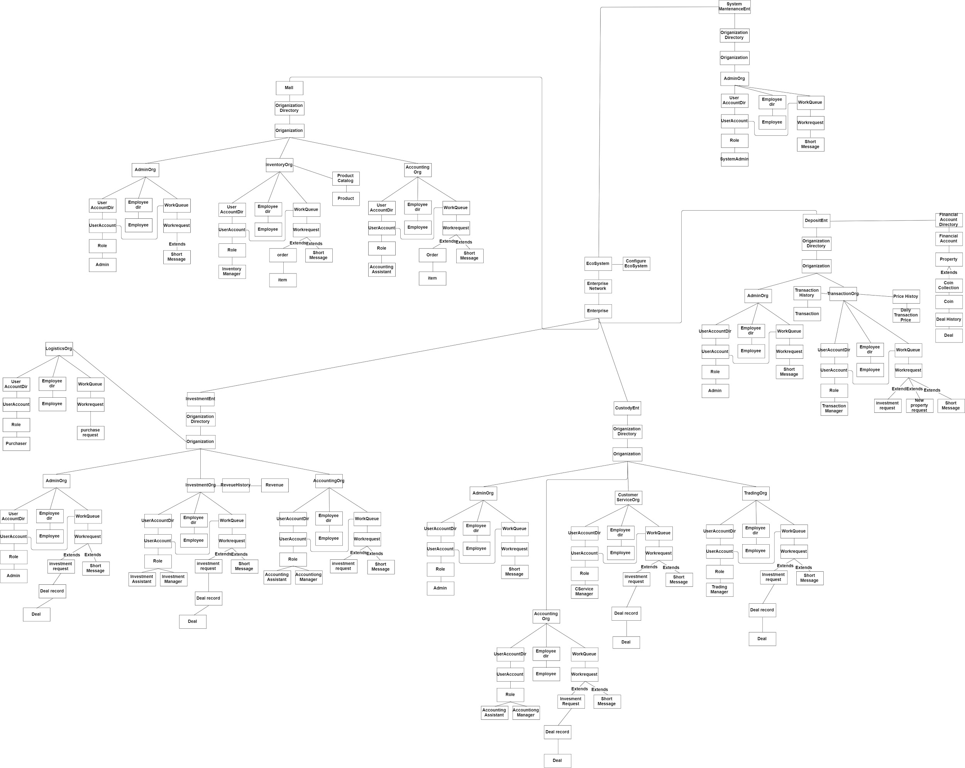
Object Model(link)

Slide 7
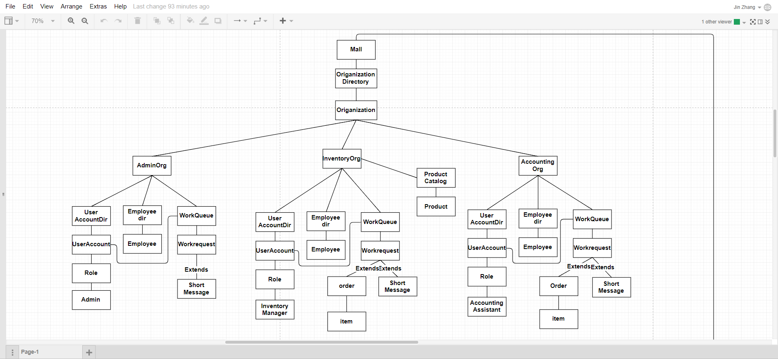
Object Model MallEnterprise

Slide 8
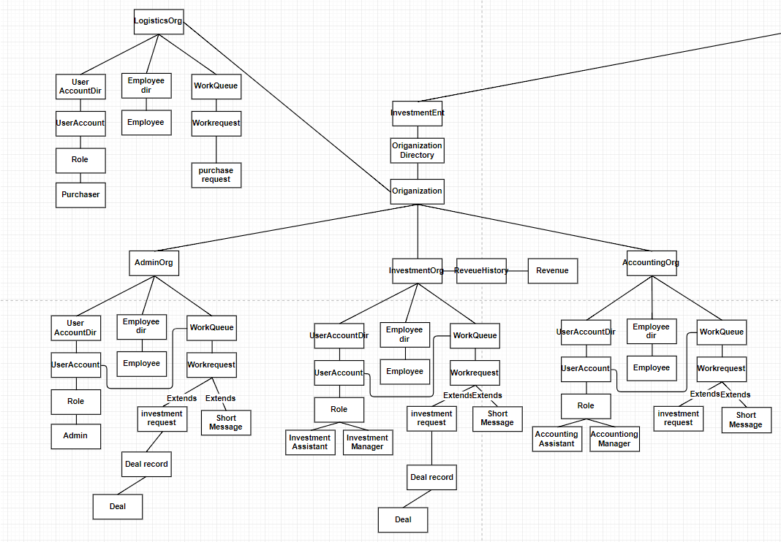
Object Model Investment Enterprise

Slide 9
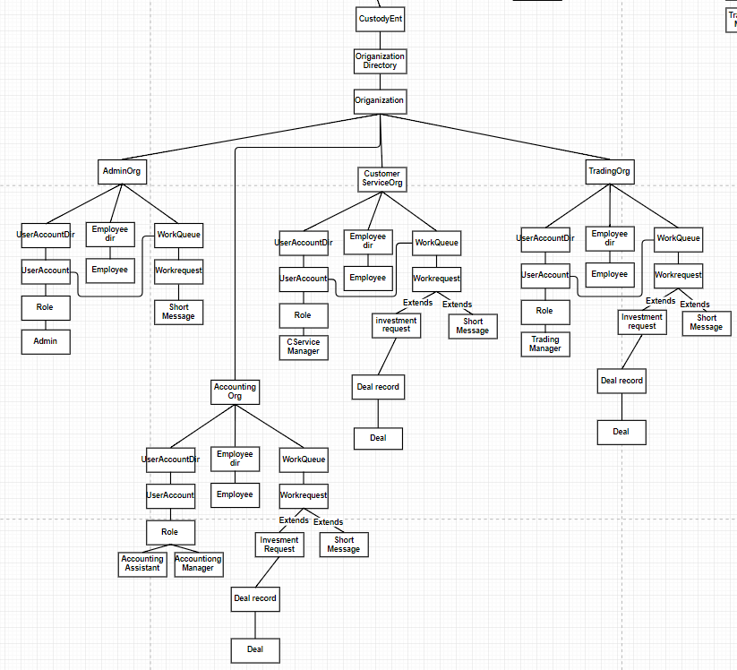
Object Model Custody Enterprise

Slide 10
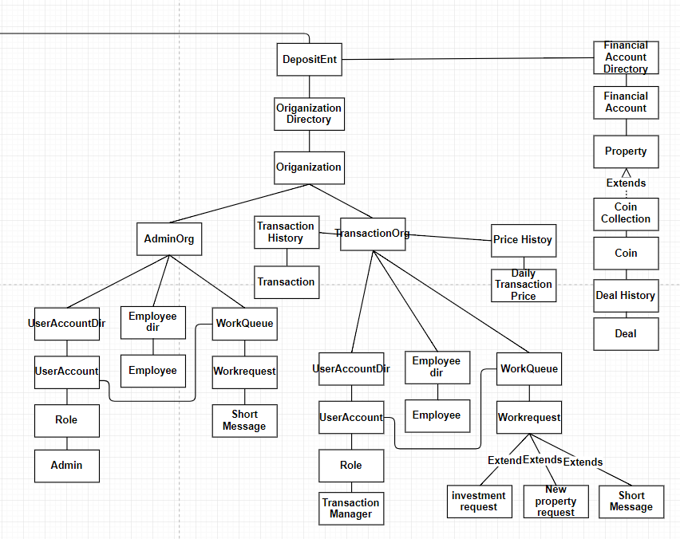
Object Mode Deposit Enterprise

Slide 11
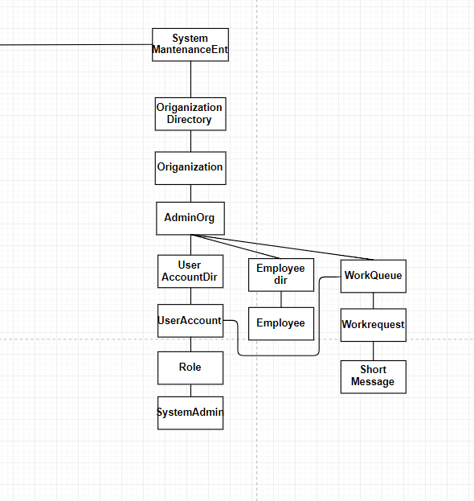
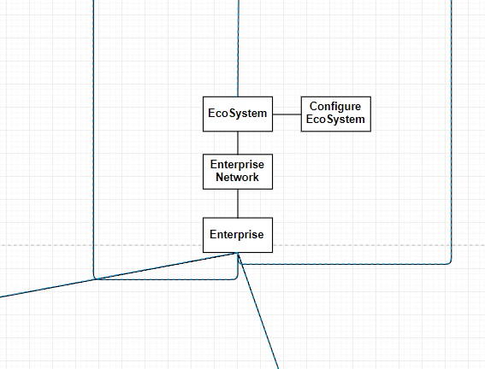
Object Model EcoSystem & System Maintenance Enterprise

Slide 12
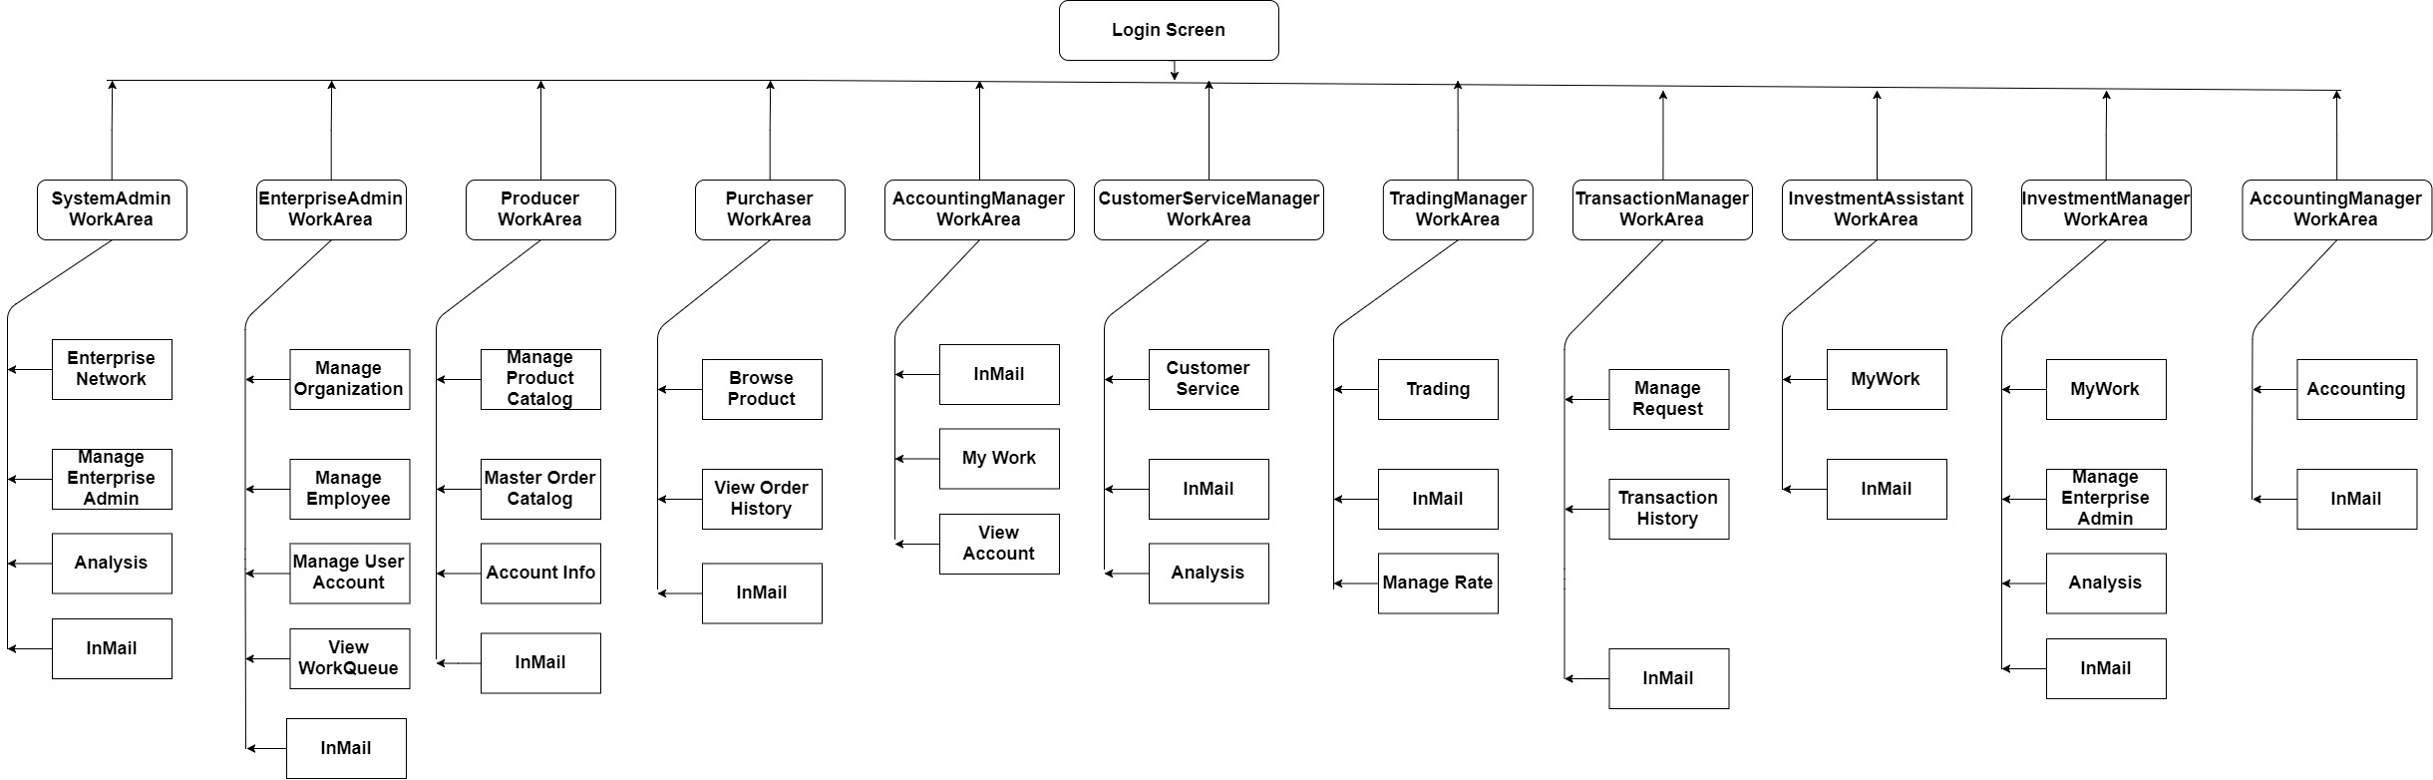
System Flow Diagram(Link)

Slide 13

Bitcoin Trading WorkFlow
The order will be matched, the buyer will find the seller
First the Investment Assistant can place two different orders.
“sell” or “buy”order.
Third the Accounting Manager received the order, and check the Finance Account
The Accounting Assistant will verify the finance condition.And send feedback to Trading Manager
“ia” Investment Assistant
“am” AccountingManager
“aa” AccountingAssistant
“mm” Transaction Manager
“im” InvestmentManager
“tm” Trading Manager
“tm” Trading Manager
Second the Investment Manager will receive the order request and make a conformation then send to the Accounting Manager.
In this step, the order status will be “open”,and The Trading Manager will get the info from it then send to Accounting Assistant to check the finance condition about the specific Investment.
Finally, the order status will turn to “ready to trade”, and the Trading Manager can send the order to Deposit(Transaction) Enterprise which represent the market.

Slide 14

SCREENSHOTS

Slide 15
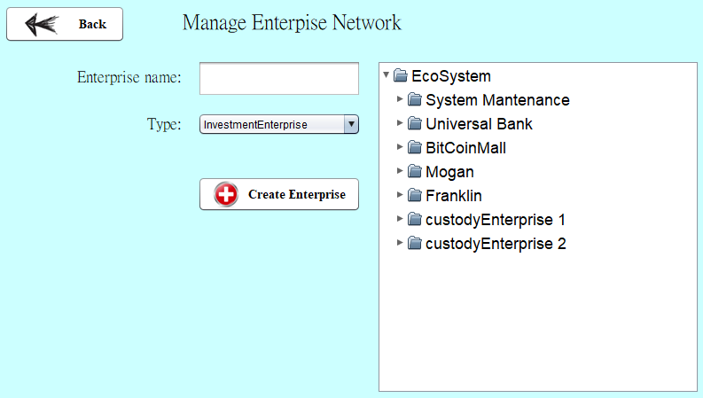
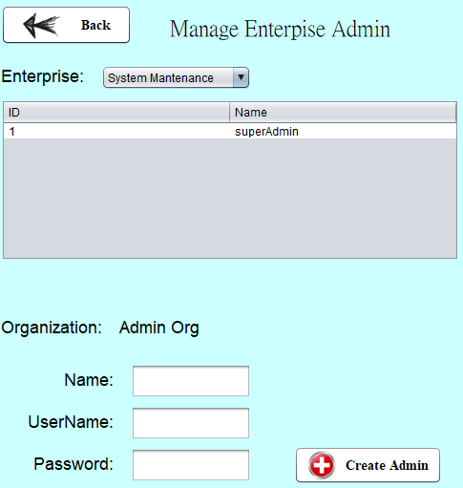
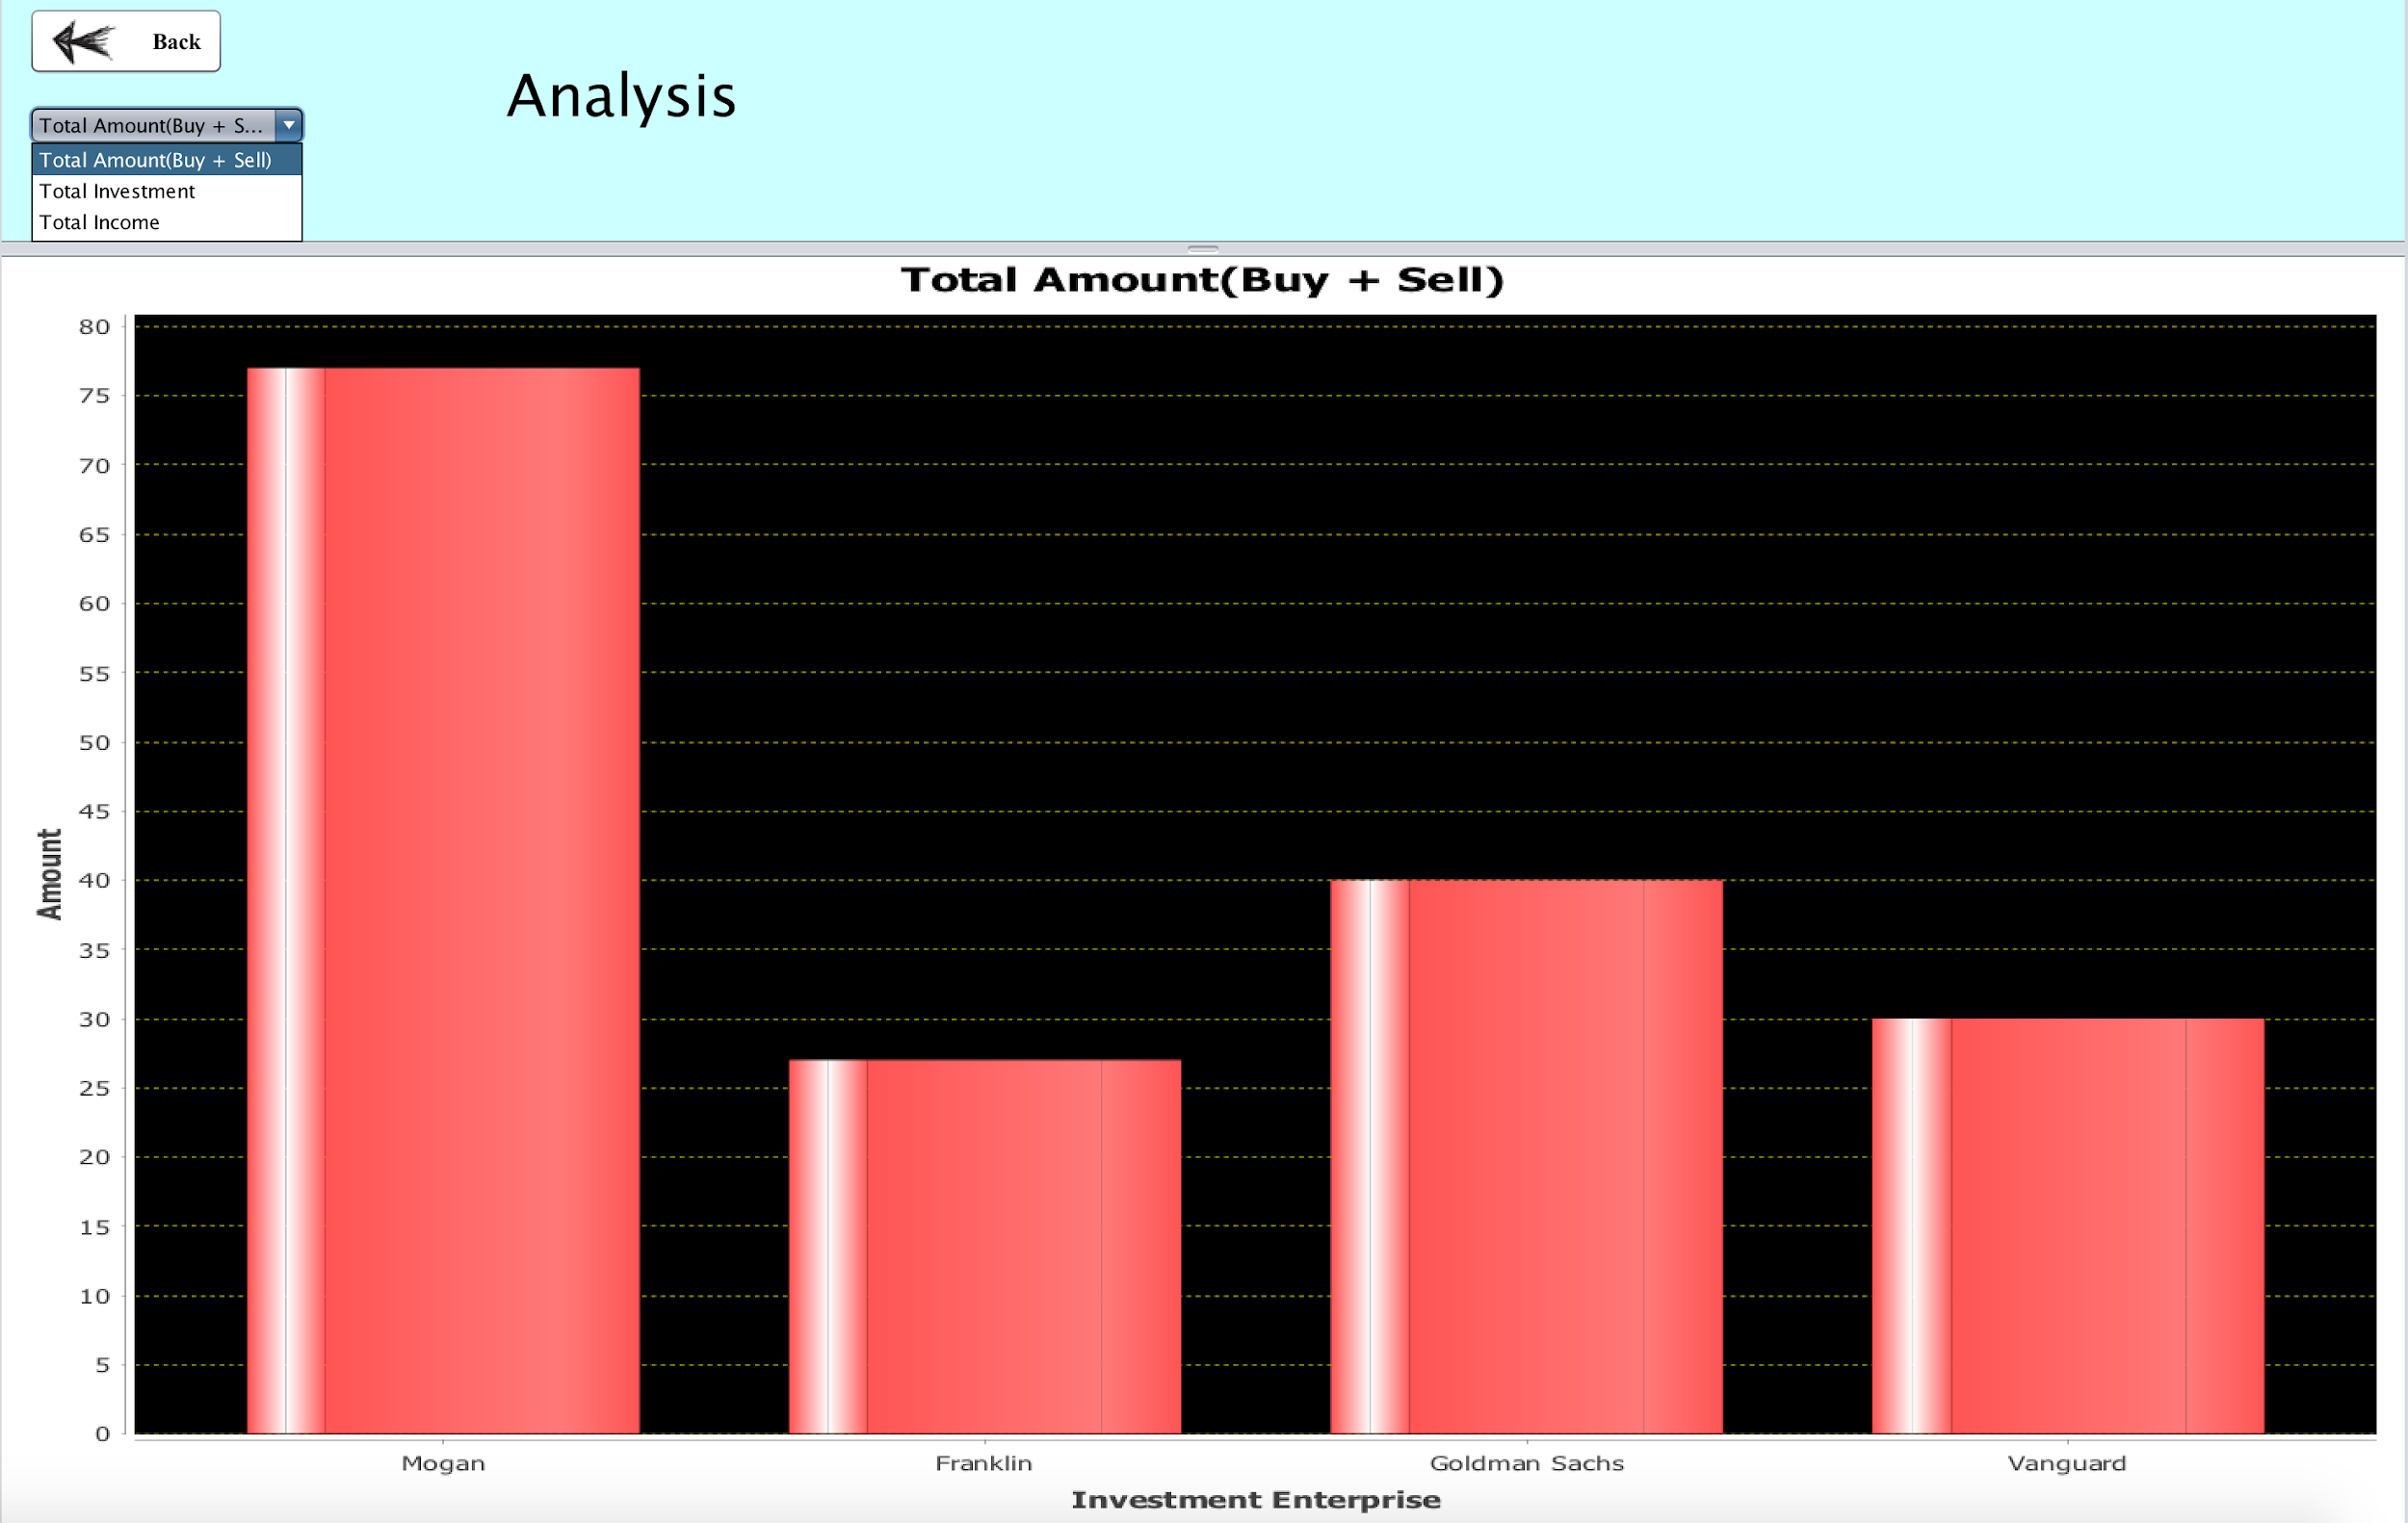
Super Administrator
View full Enterprise Network
Create new Enterprise
Compare Amount, income and investment between Enterprises
Create new administrator
with user account

Slide 16
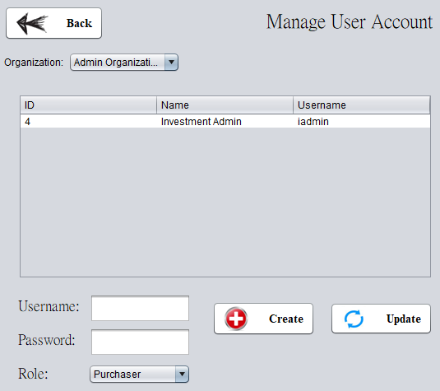
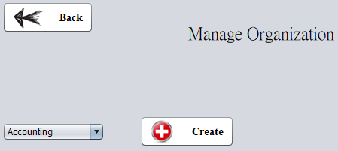
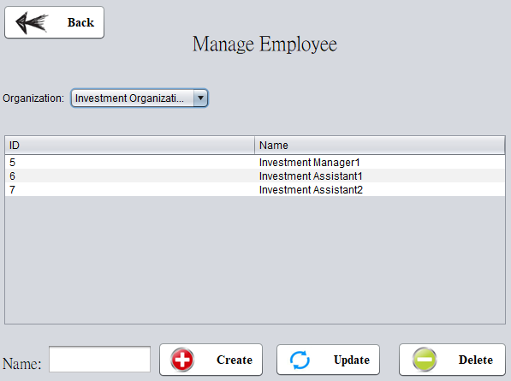
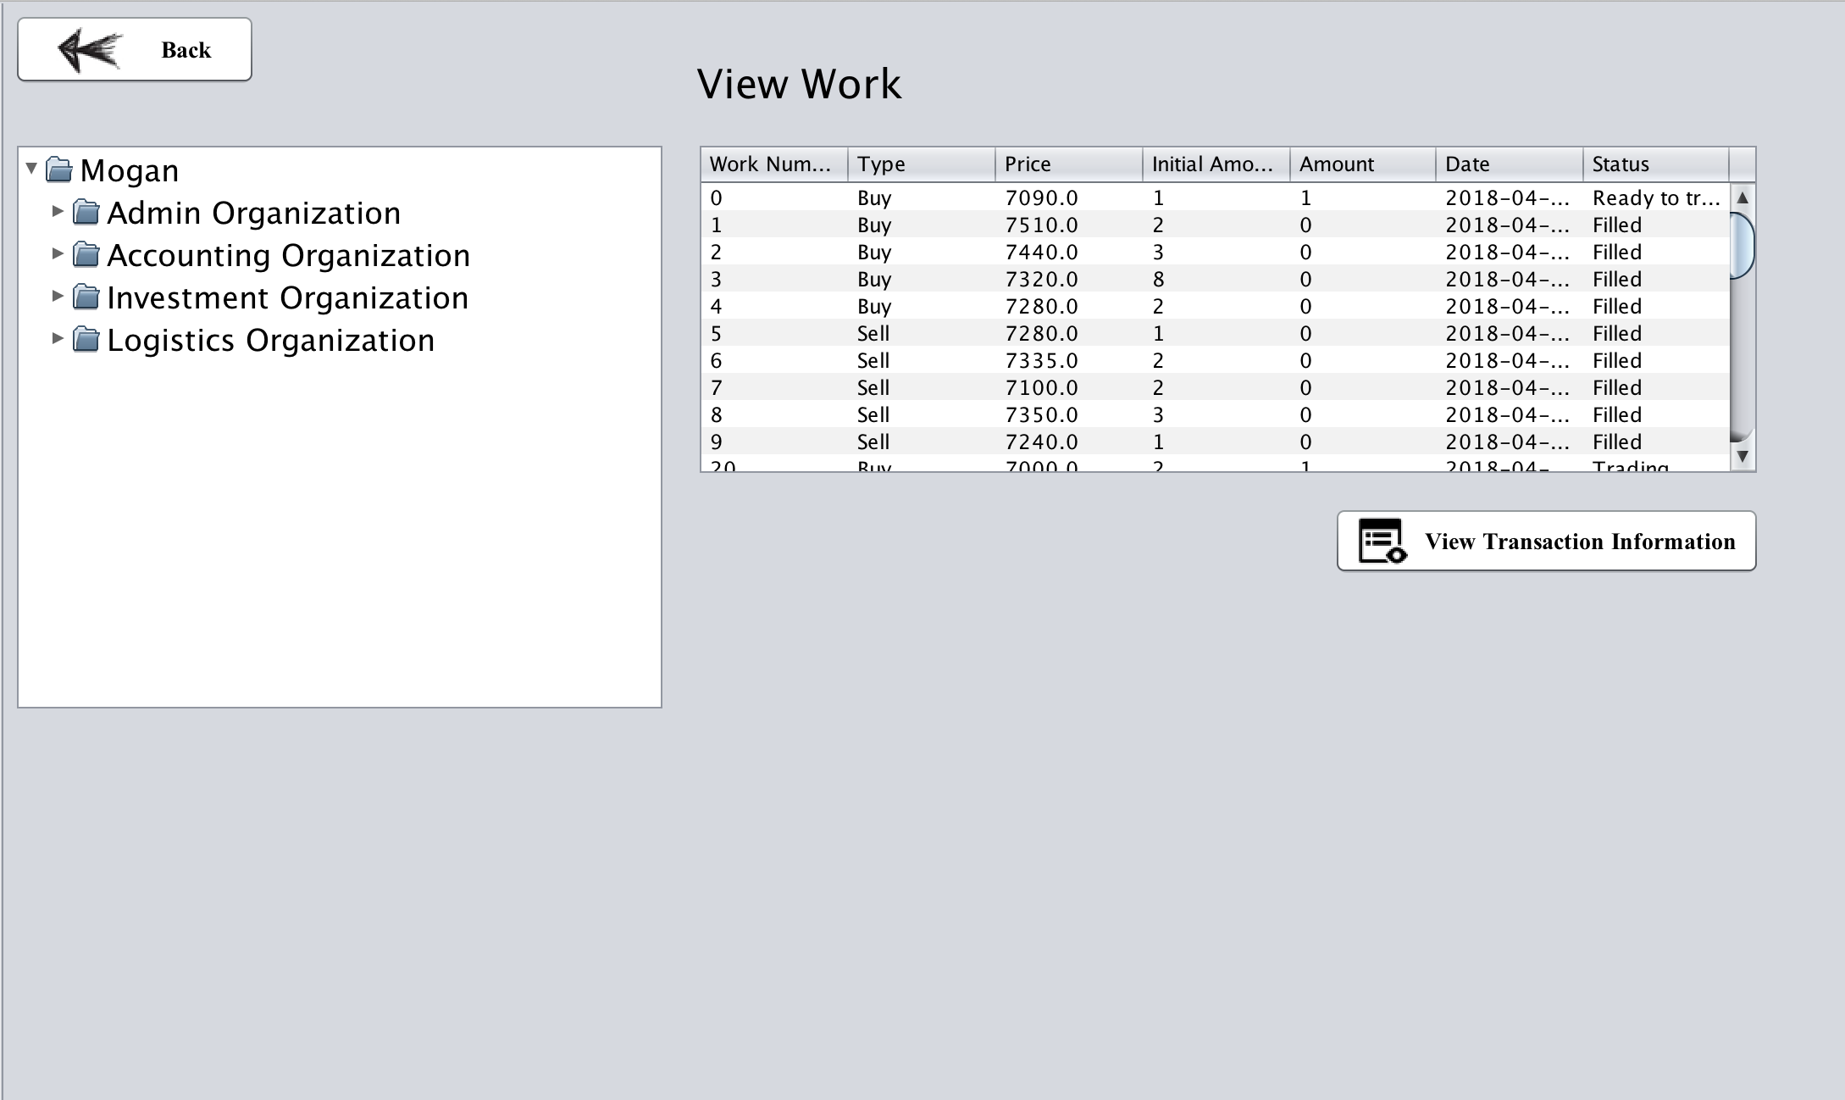
Administrator Role
Create corresponding Organization
Manage User Account of each Employee
Manage Employee within Enterprise
View full Workqueue within enterprise / of each Employee
Show full deal record

Slide 17
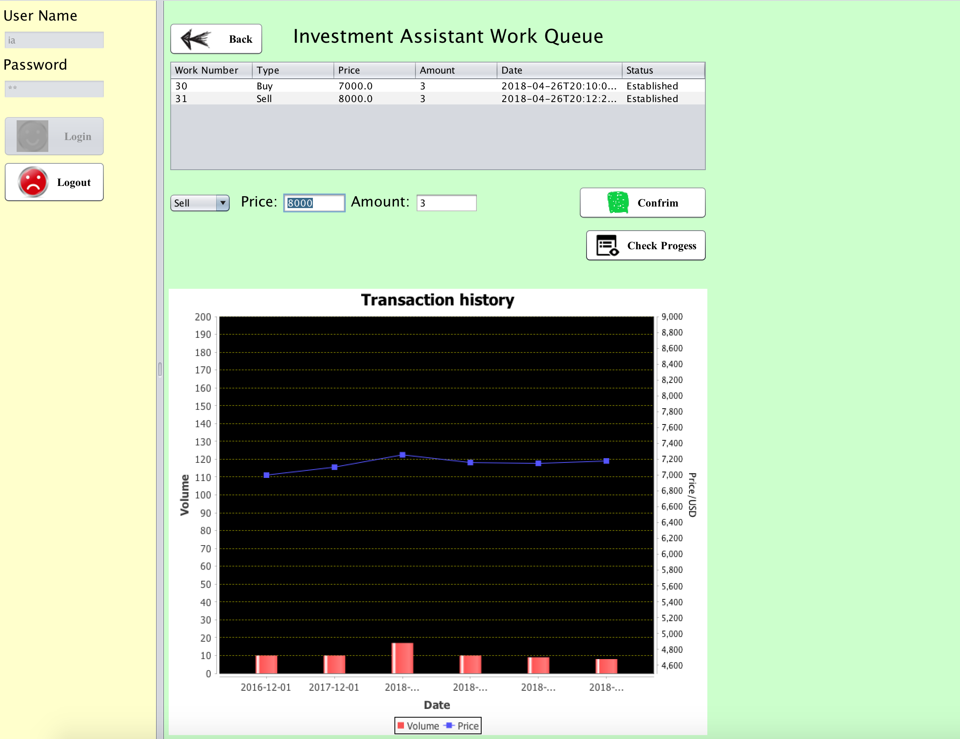
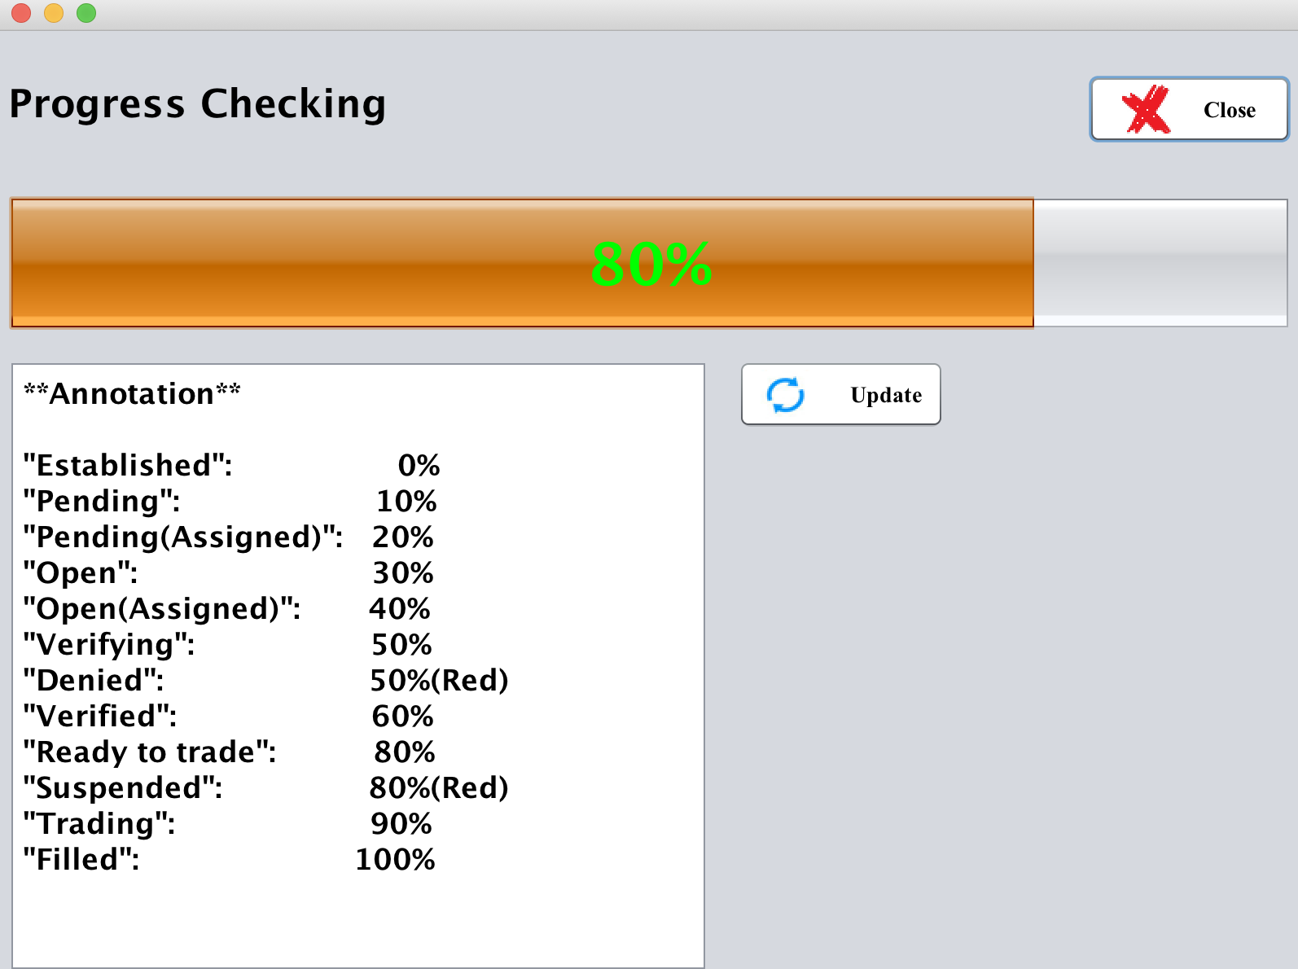
Investment Assistant
Send to Investment manager
Just in time graphic view of request progress

Slide 18
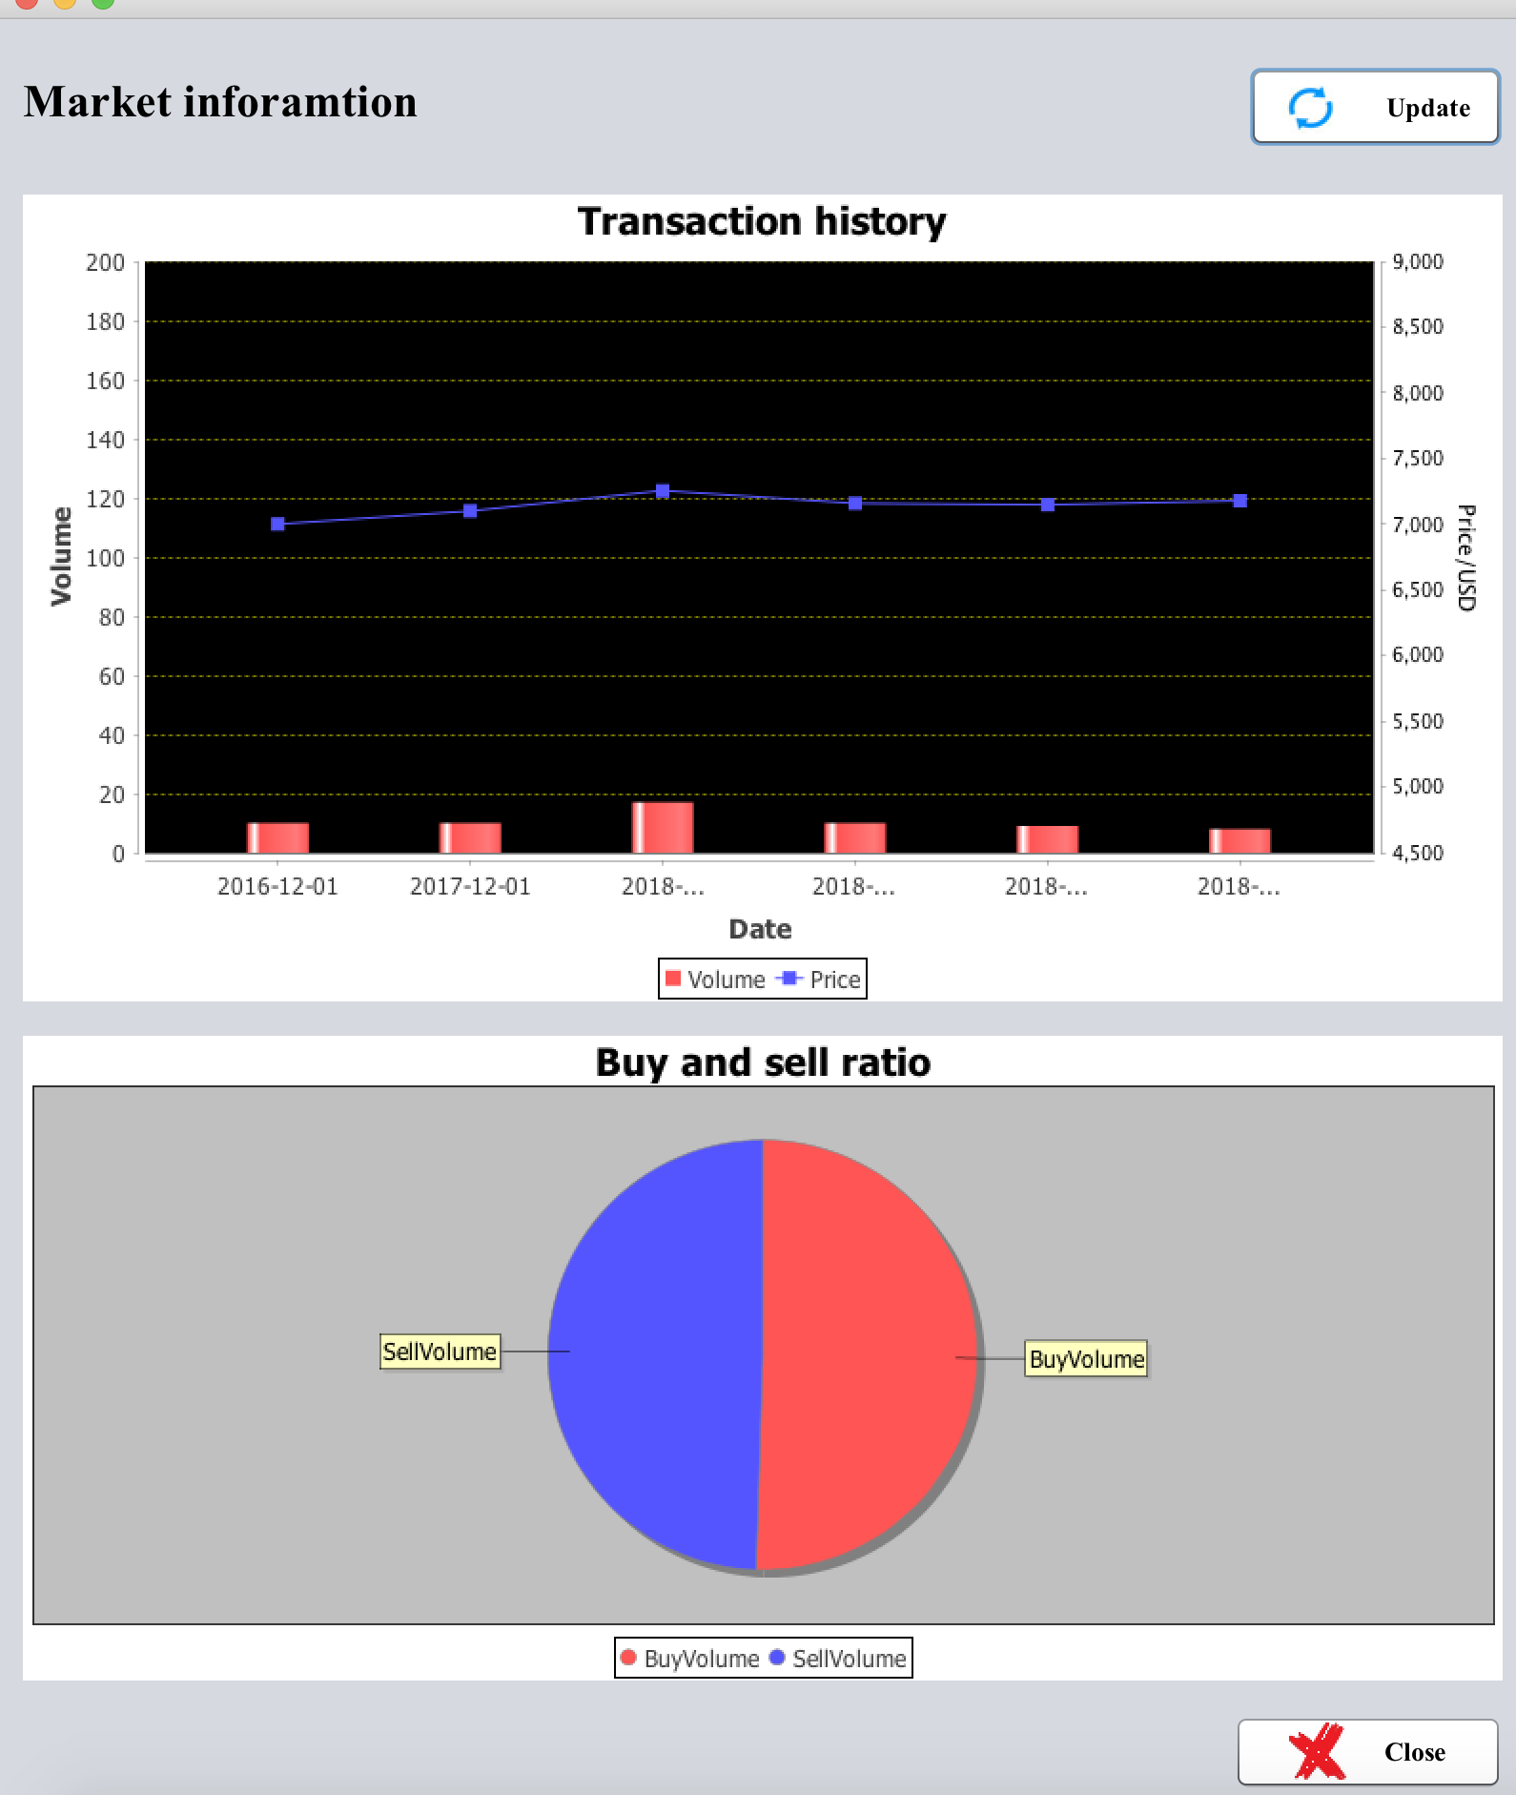
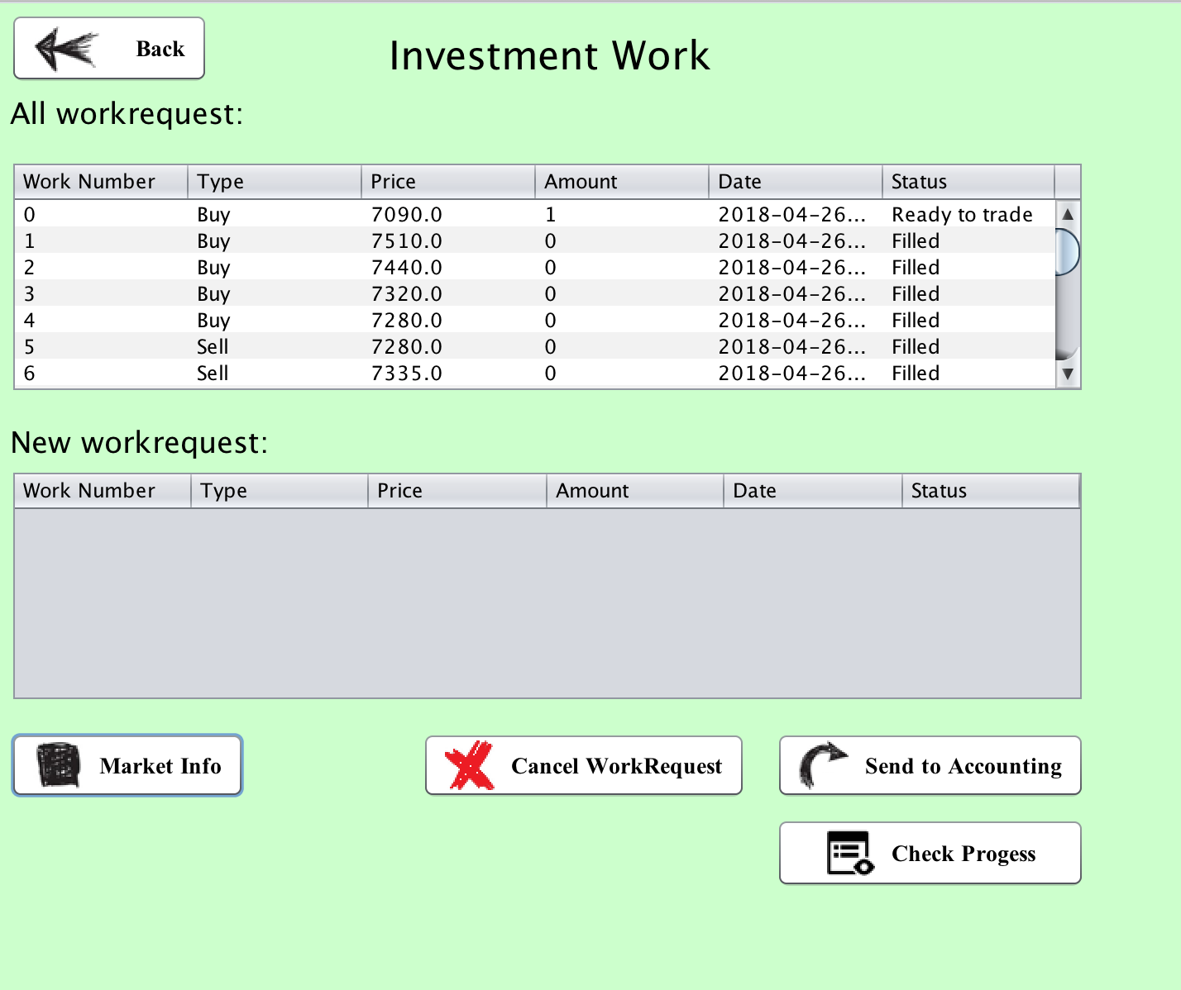
Investment Manager
View dynamic market information and analysis

Slide 19
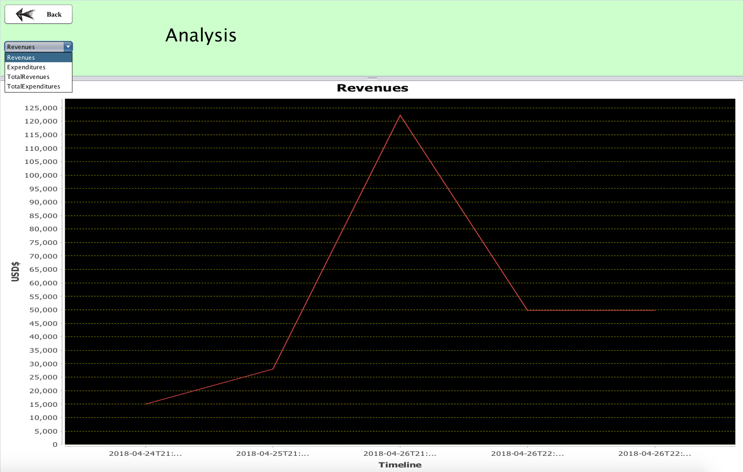
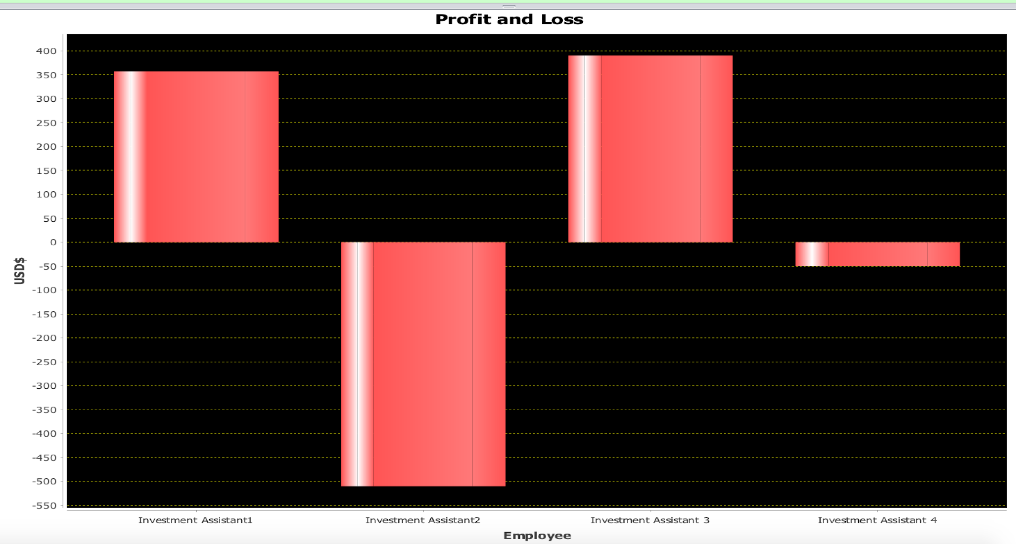
Investment Manager
subordinate performance analysis
Enterprise revenue and expenditure analysis

Slide 20
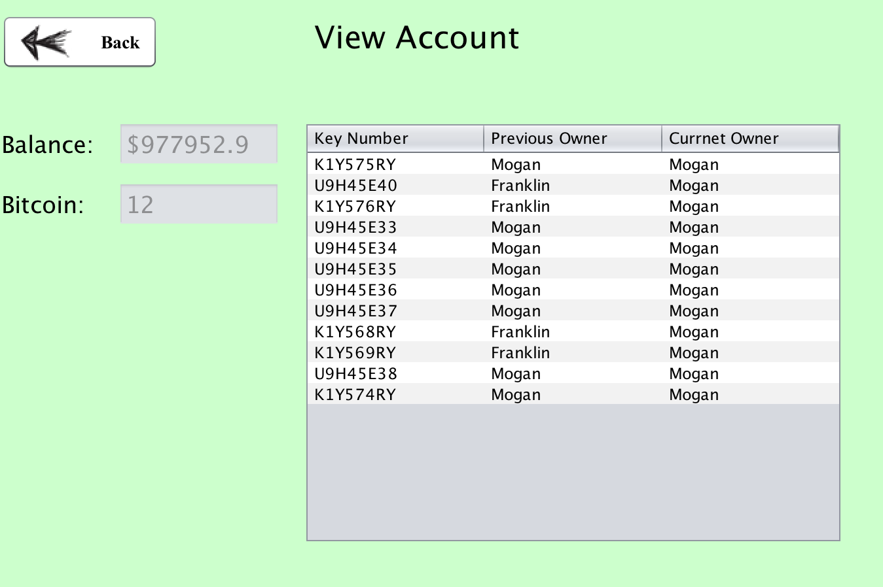
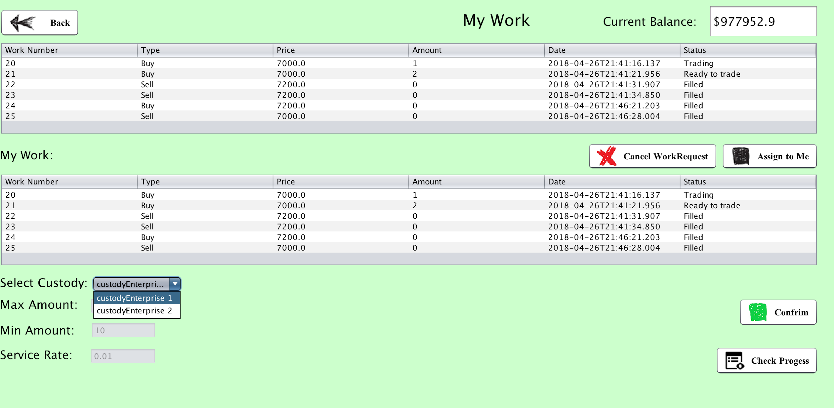
Accounting Manager
Check Financial Account
Send request to Custodian Enterprise

Slide 21
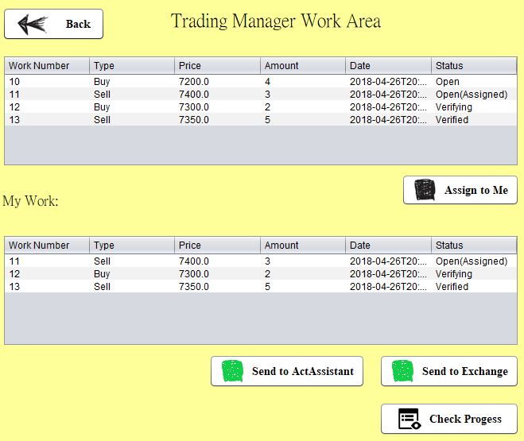
Trading Manager
Assign work to himself from Trading Organization
Send to Accounting Organization
Send to Deposit(Transaction) Enterprise

Slide 22
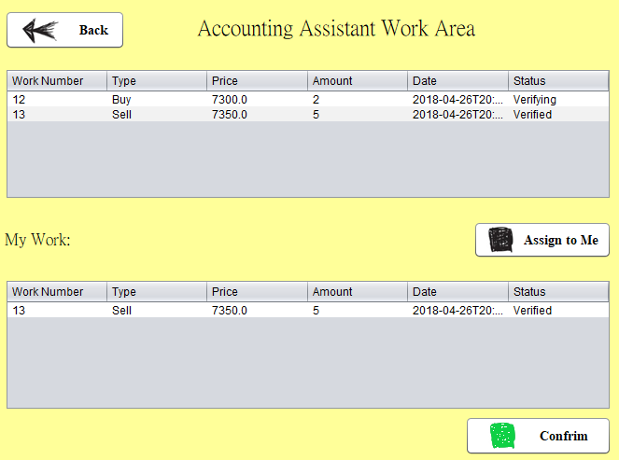
Accounting Assistant
Assign work to himself from Accounting Organization
Check currency and Bitcoin balance
Validate Bitcoin

Slide 23
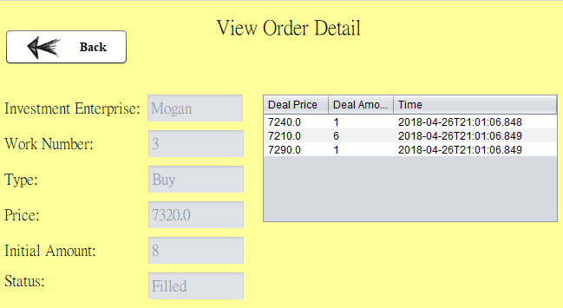
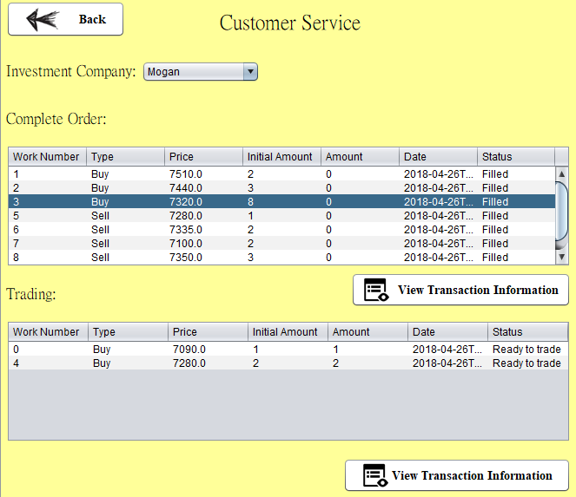
Customer Service Manager
View transaction record

Slide 24
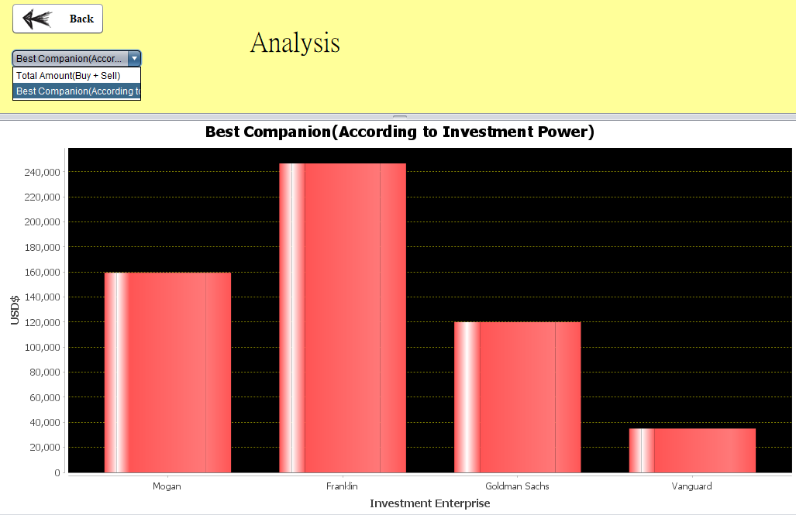
Customer Service Manager
Compare Bitcoin investment amount between investment enterprise
Compare Investment power between investment enterprise

Slide 25
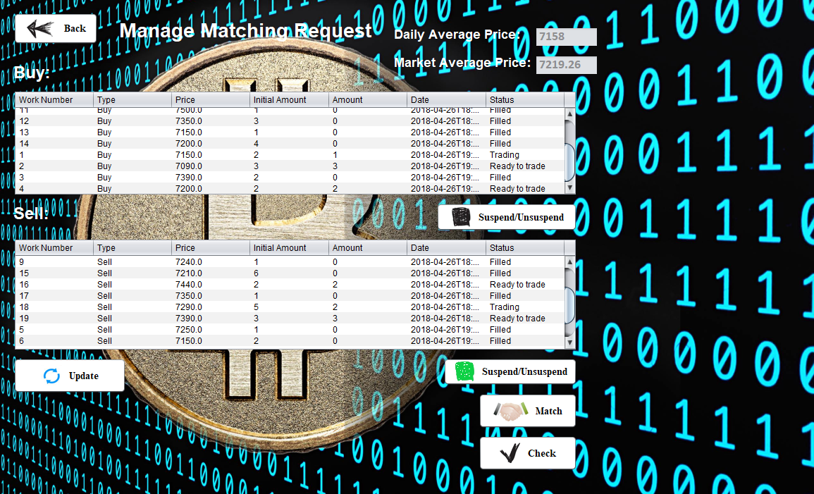
Transaction Manager
Show current and history average price
Order has been Completed
Order not Complete(Could be caused by no corresponding order, exceeding price or no enough currency and Bitcoin)
Partial deal(One Order could have different deal prices in each deal)
Match buy and sell requests, calculate average price and create deal record

Slide 26
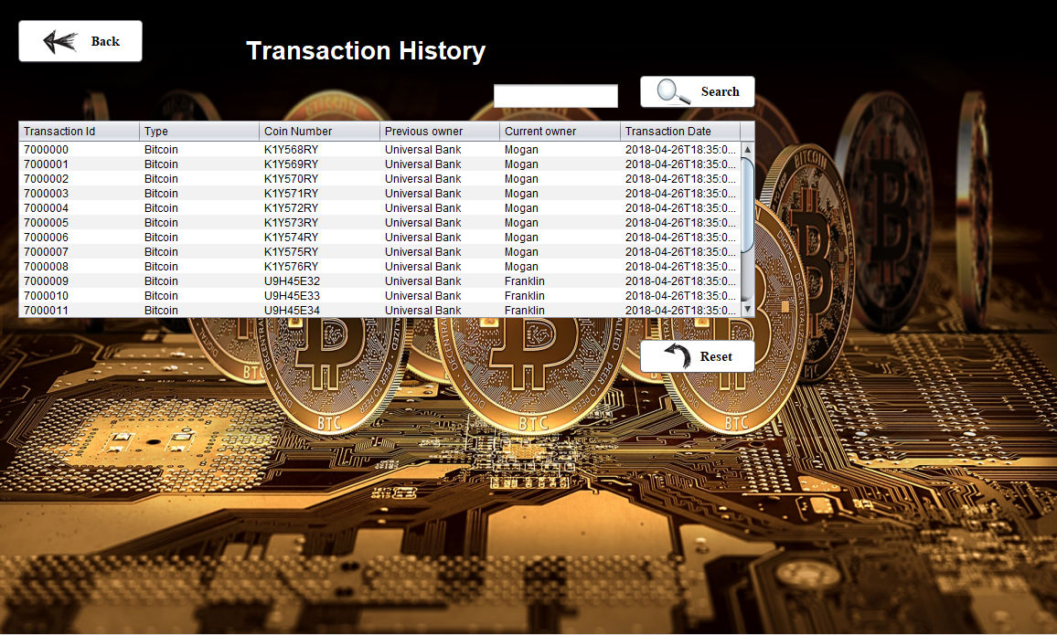
Transaction Manager
Search transaction history by Coin Key
Transaction history of each Bitcoin
Each Transaction record is Immutable

Slide 27
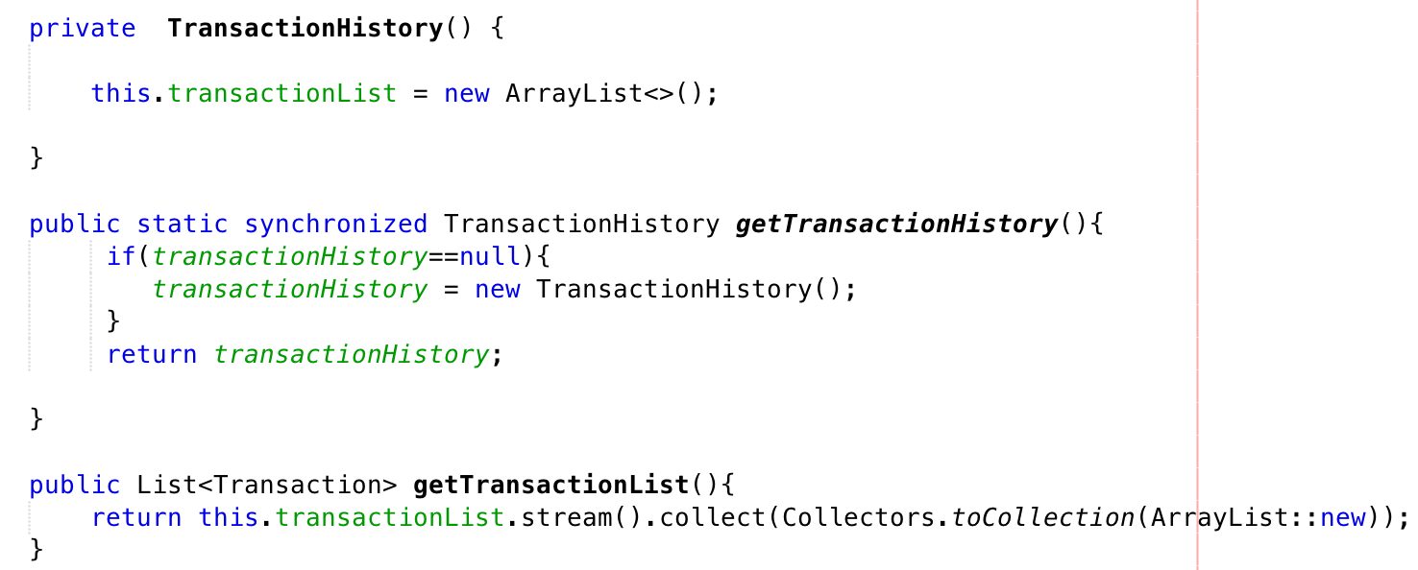
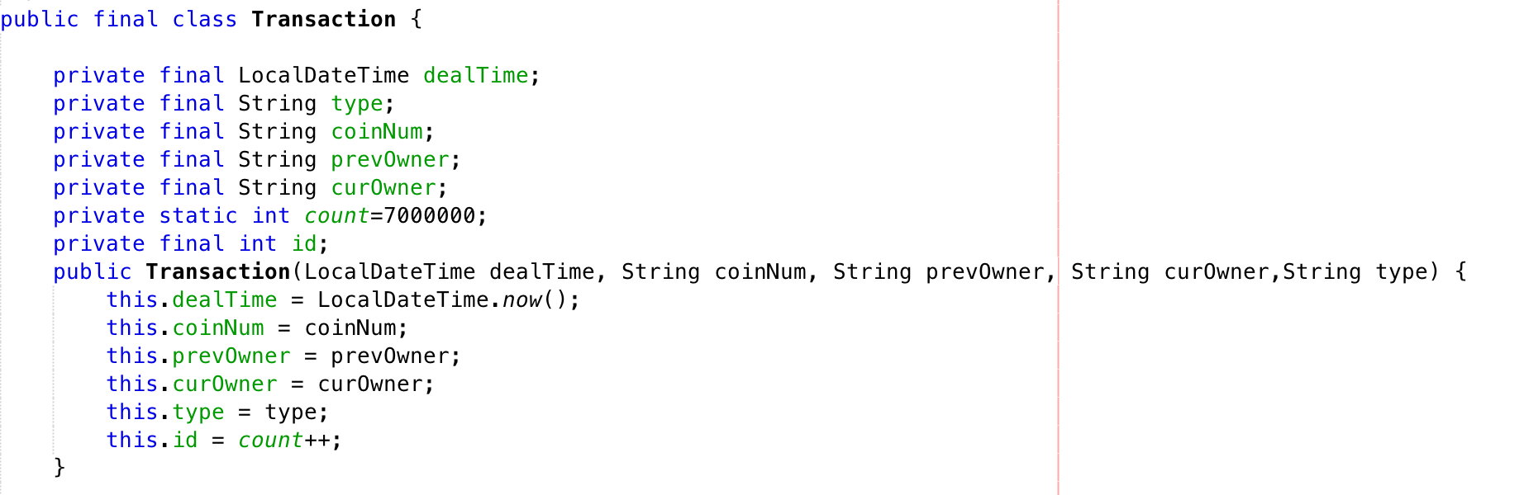
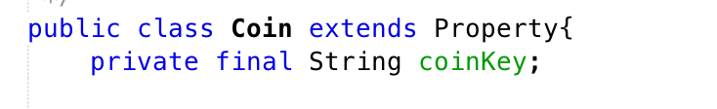
Security Design
Singleton Design pattern
&&
Immutable Object design
&&
Stream API to keep data safe

Slide 28
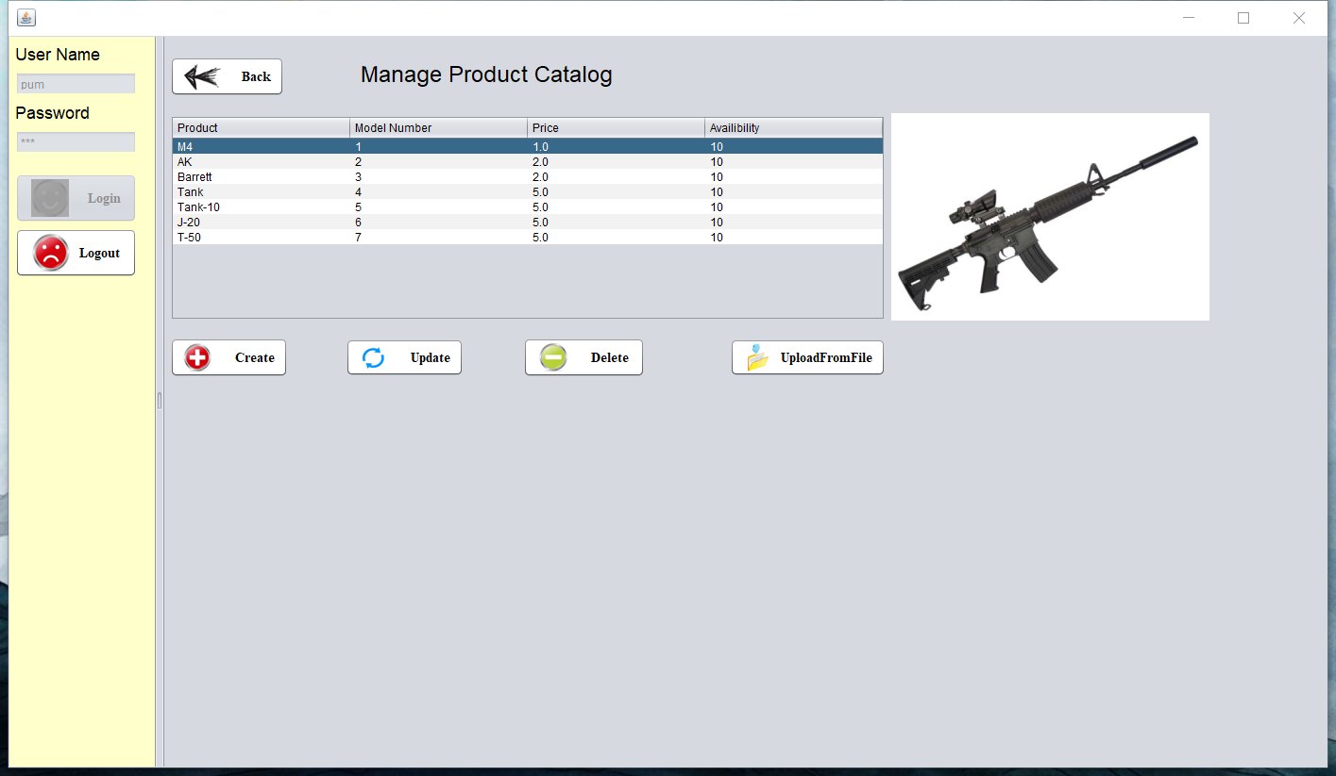
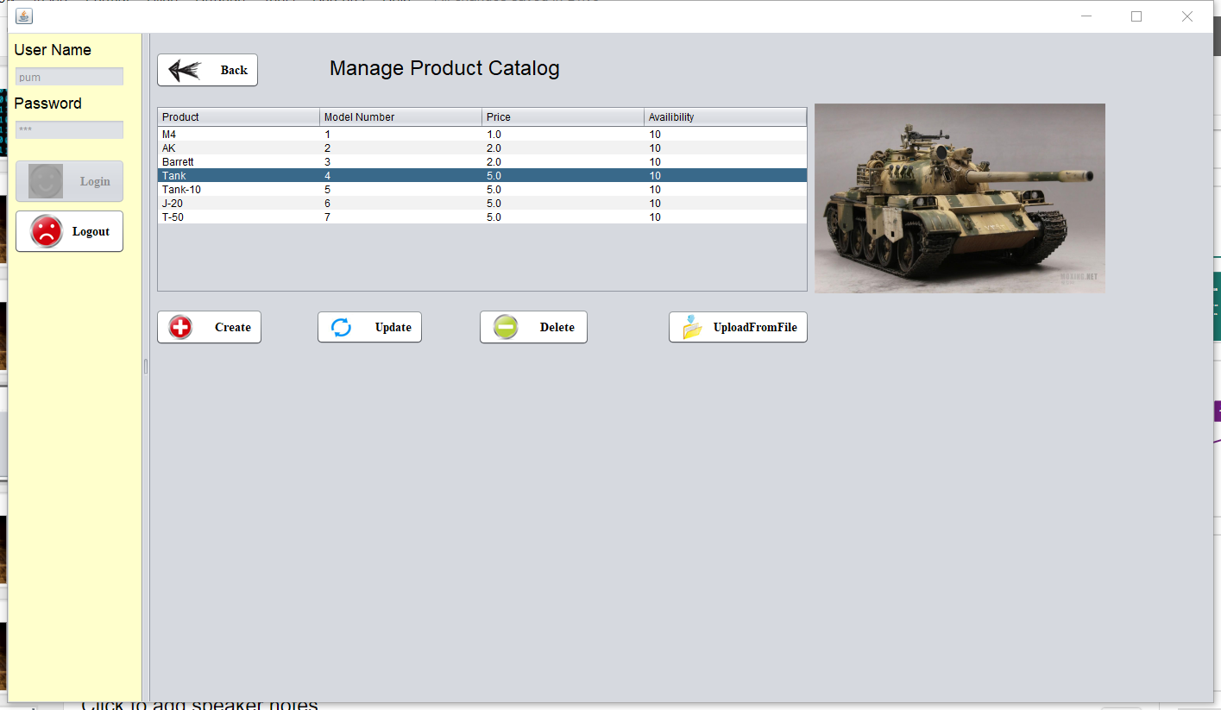
Producer

Slide 29
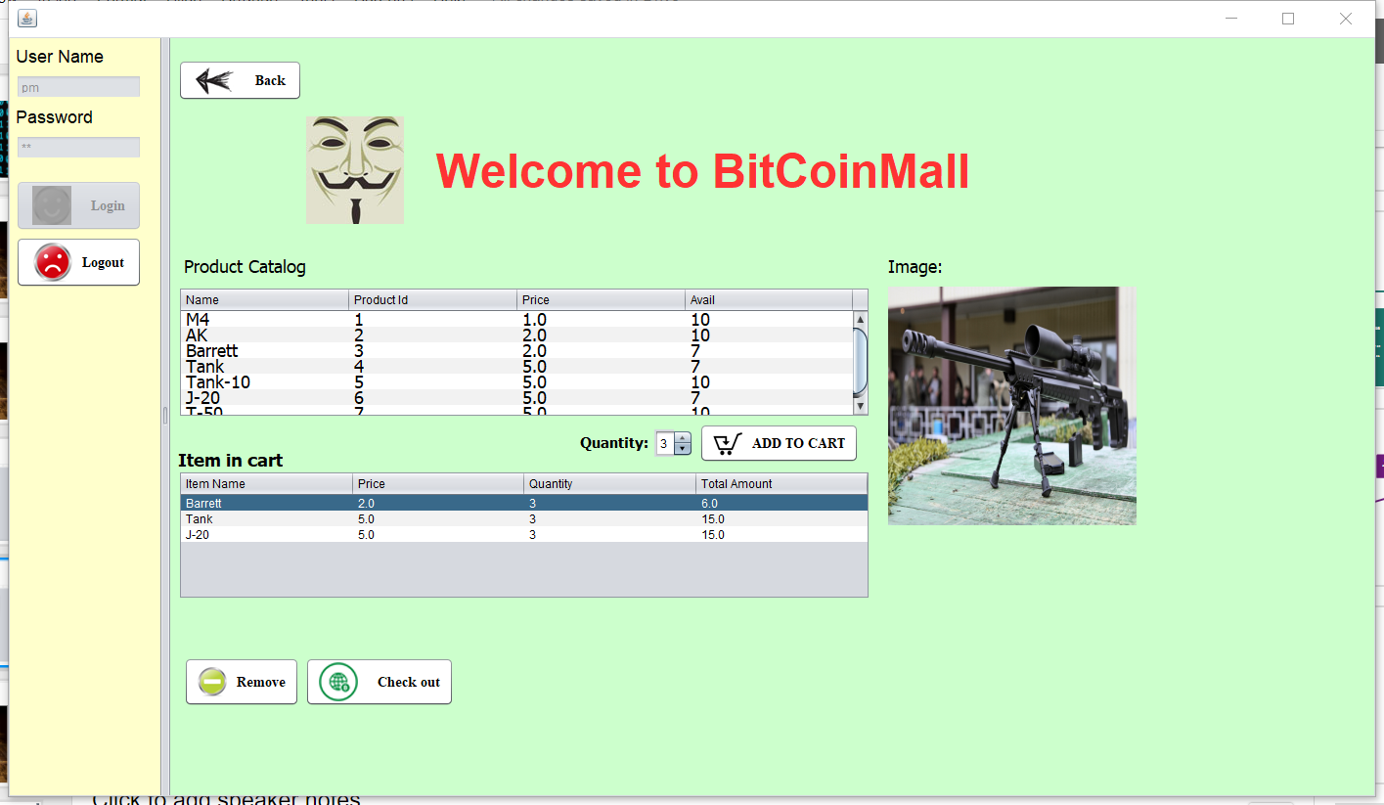
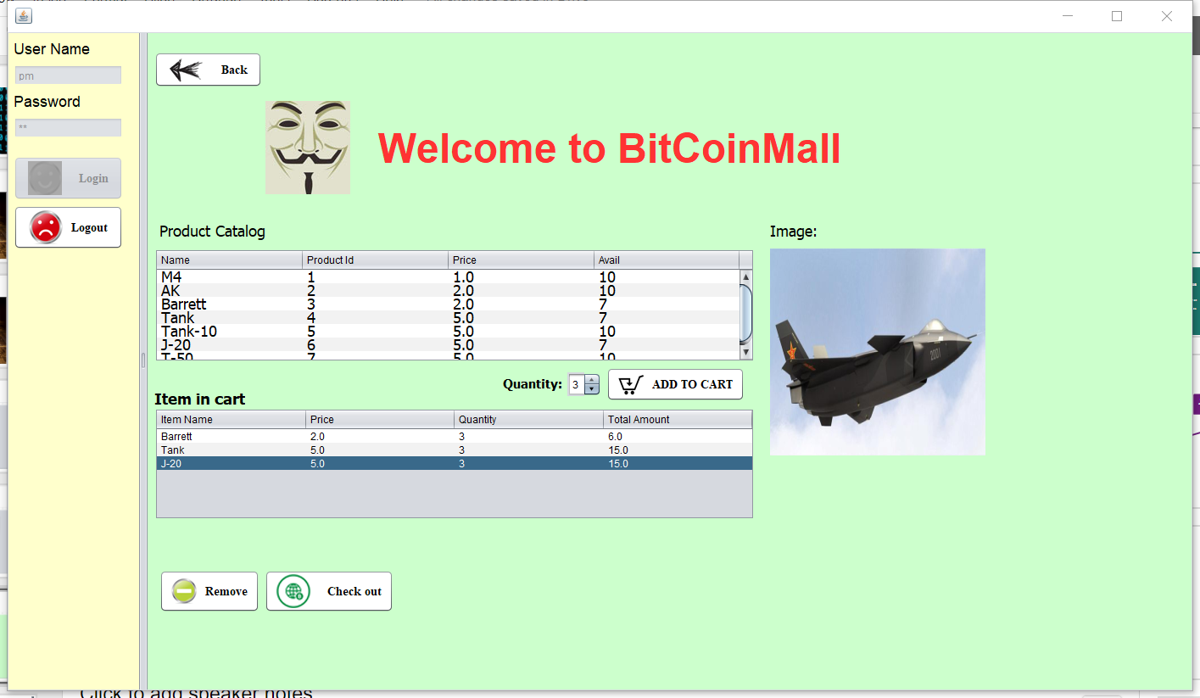
Purchaser

Slide 30
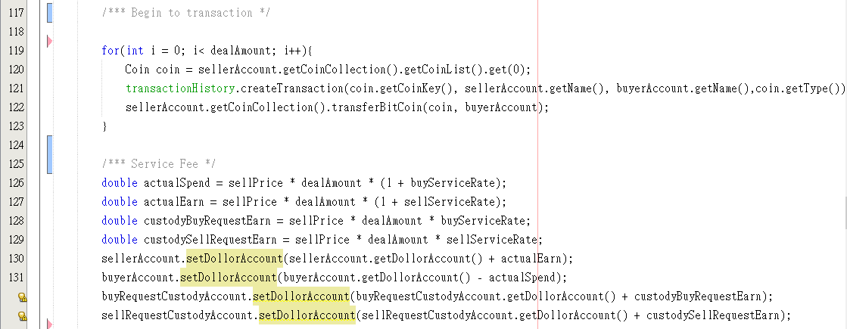
Transaction Algorithm

Slide 31
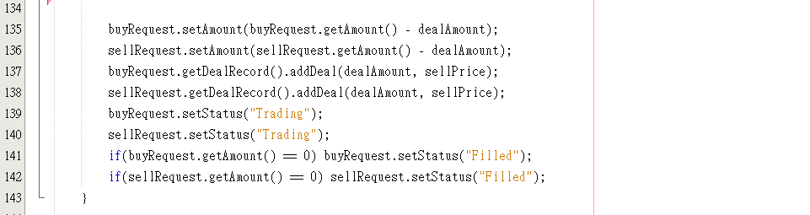
Transaction Algorithm

Slide 32
Thank you !!!

